Slide 1
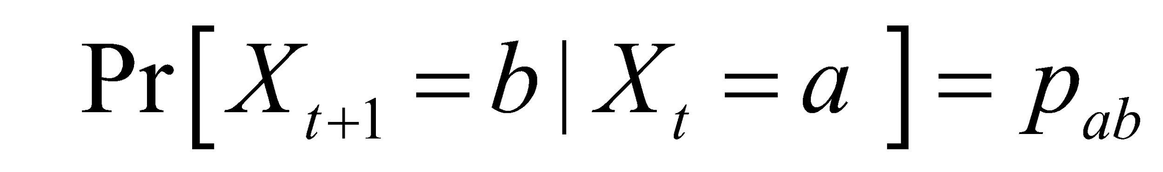
Markov Process
• Markov Property: The state of the system at time t+1 depends only on the state of the system at time t
X₁
X₂
X₃
X₄
X₅
• Stationary Assumption: Transition probabilities are independent of time (t)
Bounded memory transition model

Slide 2
Markov Process Simple Example
Weather:
raining today 40% rain tomorrow
60% no rain tomorrow
not raining today 20% rain tomorrow
80% no rain tomorrow
Stochastic FSM:
0.4
0.6
0.8
rain
no rain
0.2

Slide 3
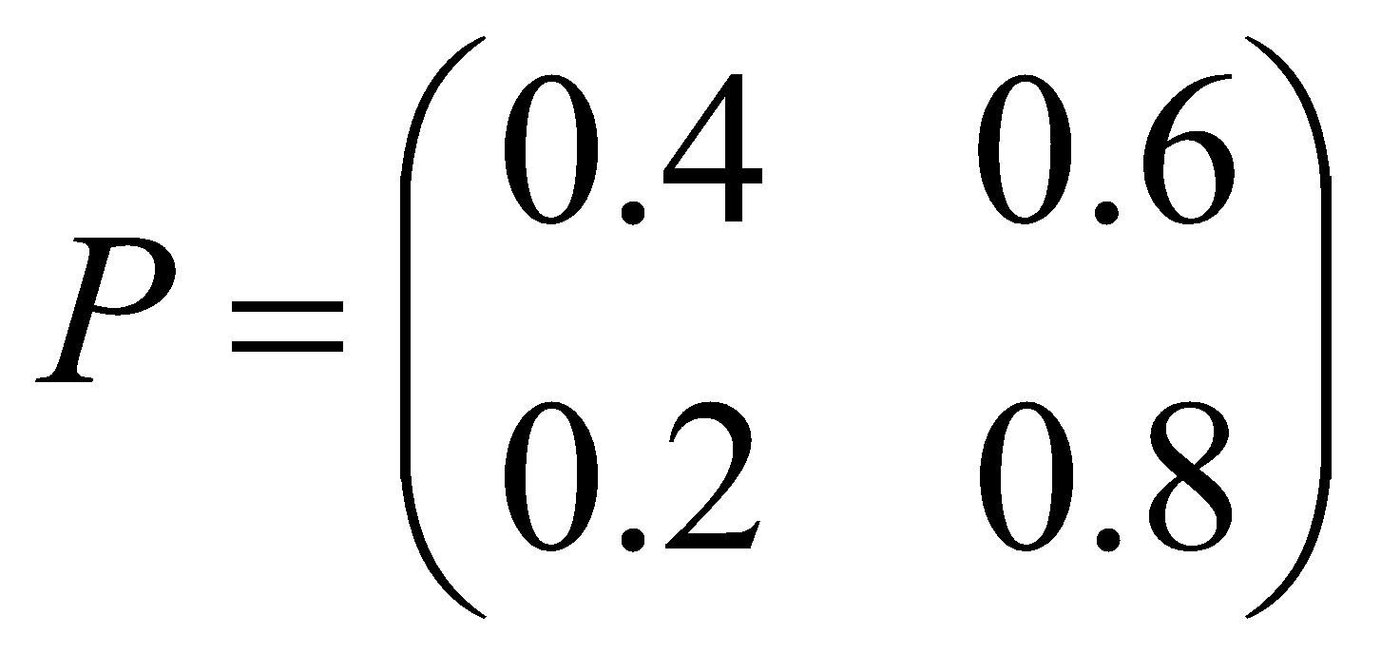
Markov Process Simple Example
Weather:
raining today 40% rain tomorrow
60% no rain tomorrow
not raining today 20% rain tomorrow
80% no rain tomorrow
The transition matrix:
Stochastic matrix:
Rows sum up to 1
Double stochastic matrix:
Rows and columns sum up to 1

Slide 4
Markov Process Gambler’s Example
– Gambler starts with $10
- At each play we have one of the following:
• Gambler wins $1 with probability p
• Gambler looses $1 with probability 1-p
– Game ends when gambler goes broke, or gains a fortune of $100
(Both 0 and 100 are absorbing states)
p
p
p
p
0
1
2
99
100
1-p
Start (10$)
1-p
1-p
1-p

Slide 5
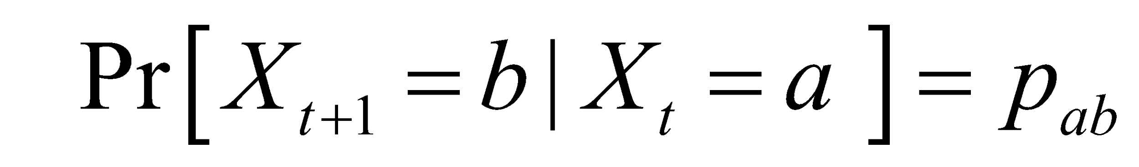
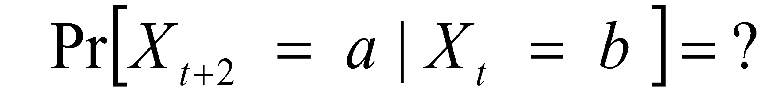
Markov Process
Markov process - described by a stochastic FSM
Markov chain - a random walk on this graph
(distribution over paths)
Edge-weights give us
We can ask more complex questions, like
p
p
p
p
0
1
2
99
100
1-p
Start (10$)
1-p
1-p
1-p

Slide 6
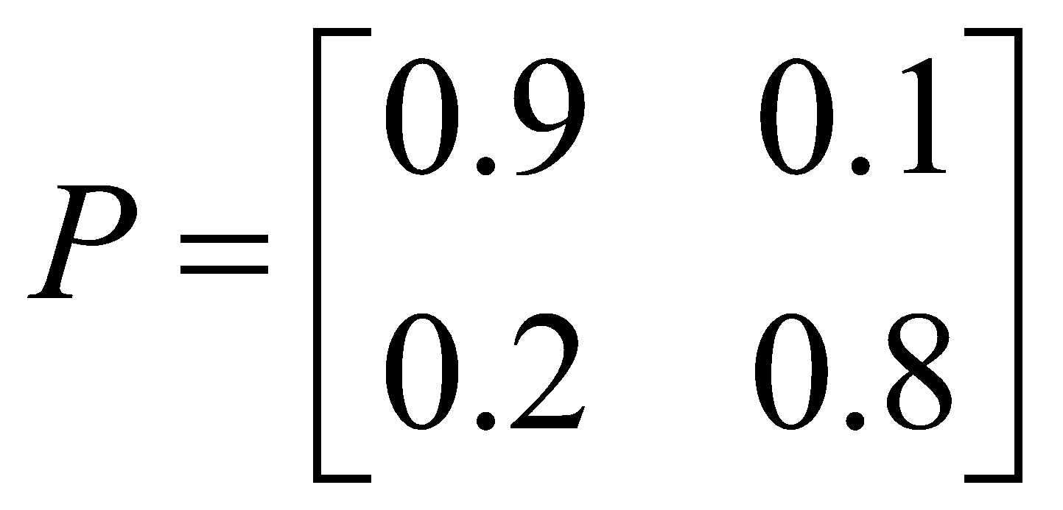
Markov Process Coke vs. Pepsi Example
Given that a person’s last cola purchase was Coke, there is a 90% chance that his next cola purchase will also be Coke.
If a person’s last cola purchase was Pepsi, there is an 80% chance that his next cola purchase will also be Pepsi.
transition matrix:
0.1
0.9
0.8
coke
pepsi
0.2

Slide 7
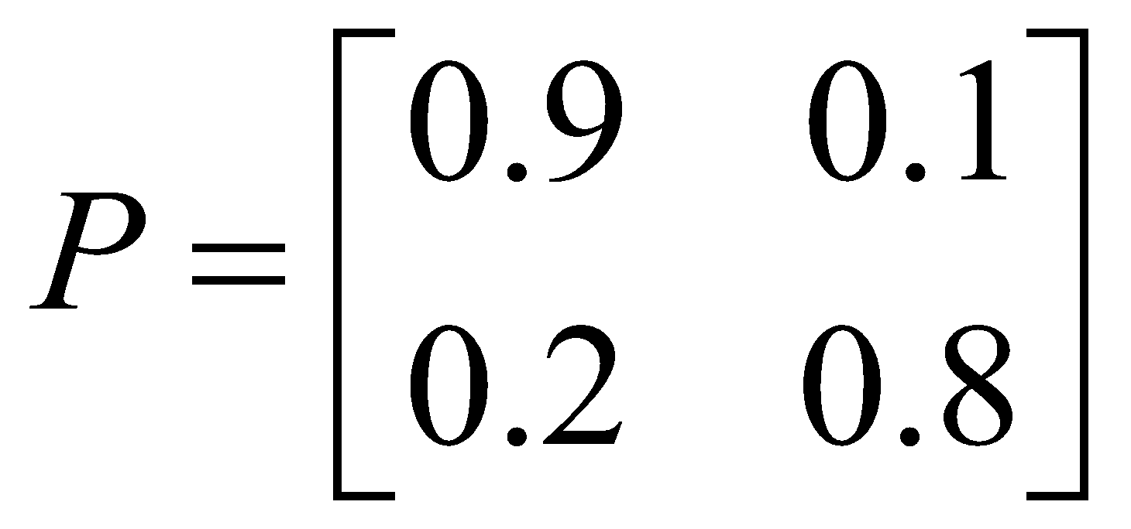
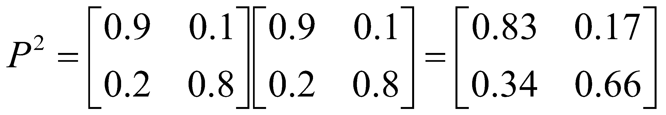
Markov Process Coke vs. Pepsi Example (cont)
Given that a person is currently a Pepsi purchaser, what is the probability that he will purchase Coke two purchases from now?
Pr[ Pepsi🡪?🡪Coke ] =
Pr[ Pepsi🡪Coke🡪Coke ] + Pr[ Pepsi🡪 Pepsi 🡪Coke ] =
0.2 * 0.9 + 0.8 * 0.2 = 0.34
Pepsi 🡪 ?
? 🡪 Coke

Slide 8
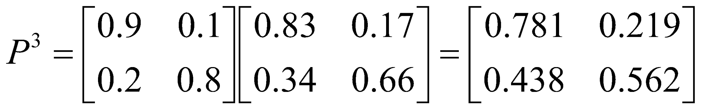
Markov Process Coke vs. Pepsi Example (cont)
Given that a person is currently a Coke purchaser, what is the probability that he will purchase Pepsi three purchases from now?

Slide 9
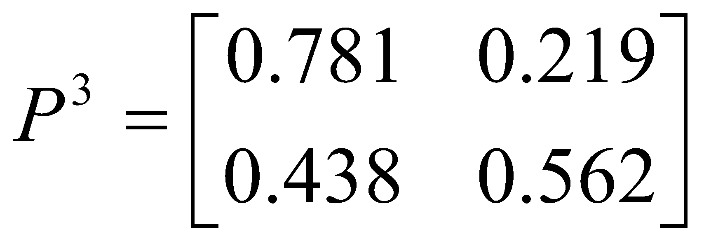
Markov Process Coke vs. Pepsi Example (cont)
Assume each person makes one cola purchase per week
Suppose 60% of all people now drink Coke, and 40% drink Pepsi
What fraction of people will be drinking Coke three weeks from now?
Pr[X₃=Coke] = 0.6 * 0.781 + 0.4 * 0.438 = 0.6438
Q_{i} - the distribution in week i
Q₀=(0.6,0.4) - initial distribution
Q₃= Q₀ * P³ =(0.6438,0.3562)

Slide 10
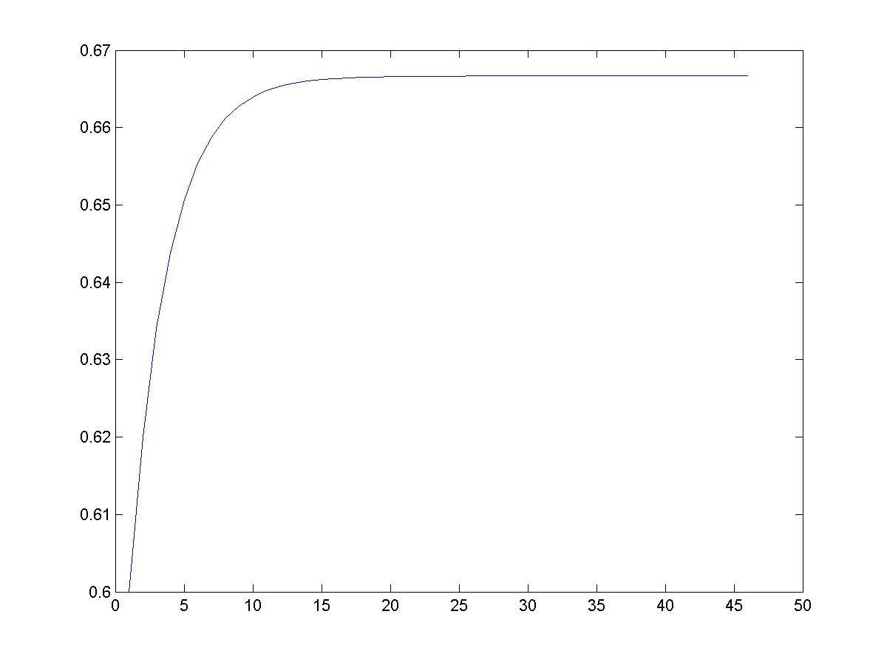
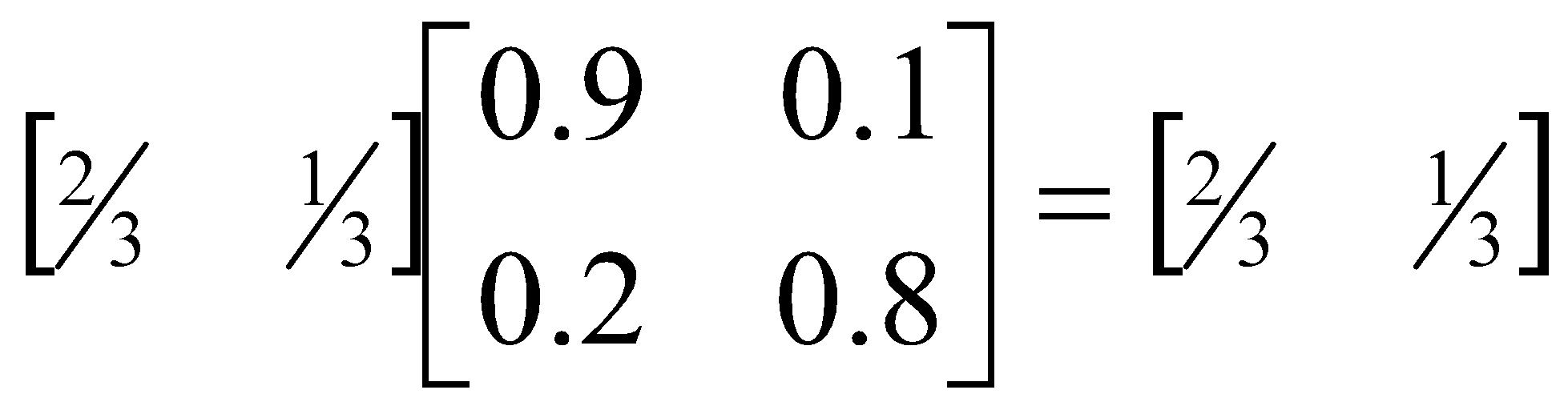
Markov Process Coke vs. Pepsi Example (cont)
Simulation:
2/3
Pr[X_{i} = Coke]
stationary distribution
0.9
0.1
0.8
coke
pepsi
0.2
week - i

Slide 11


Monte Carlo principle
Consider the game of solitaire: what’s the chance of winning with a properly shuffled deck?
Hard to compute analytically because winning or losing depends on a complex procedure of reorganizing cards
Insight: why not just play a few hands, and see empirically how many do in fact win?
More generally, can approximate a probability density function using only samples from that density
?
Lose
Lose
Win
Lose
Chance of winning is 1 in 4!

Slide 12
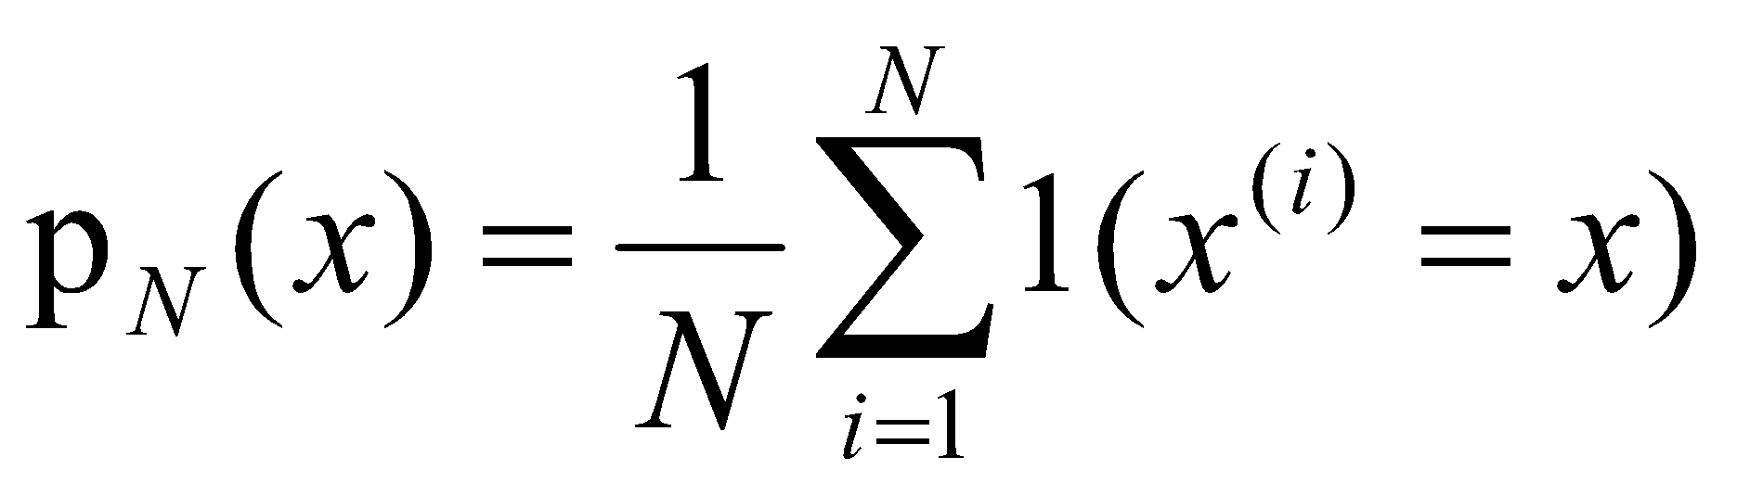
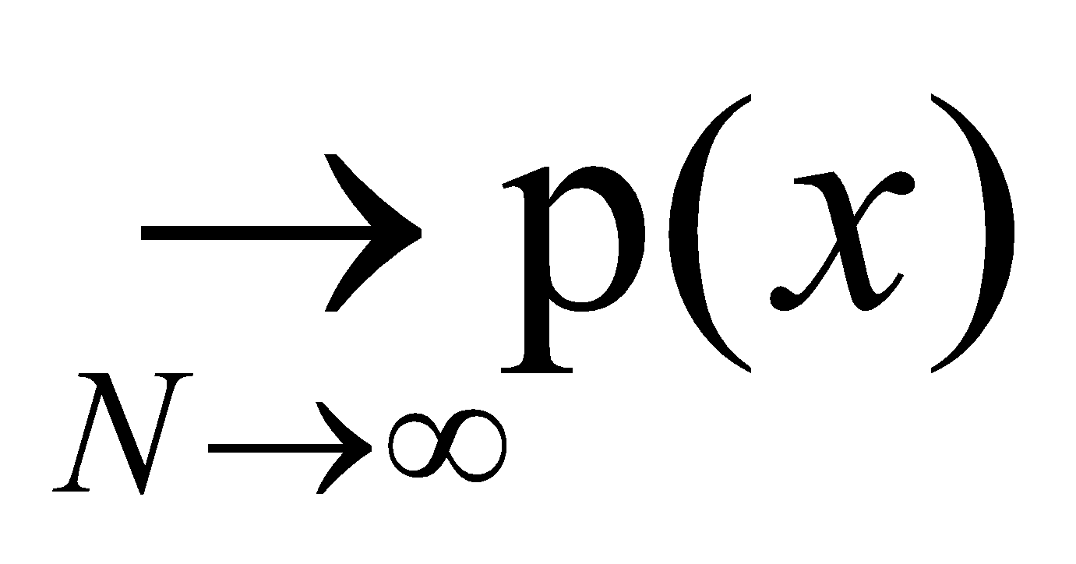
Monte Carlo principle
Given a very large set X and a distribution p(x) over it
We draw i.i.d. a set of N samples
We can then approximate the distribution using these samples
p(x)
X

Slide 13
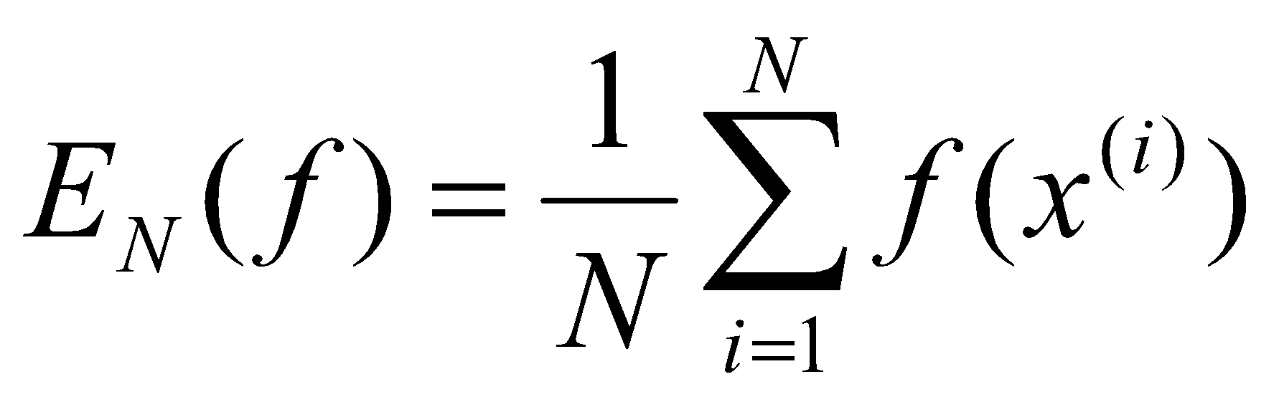
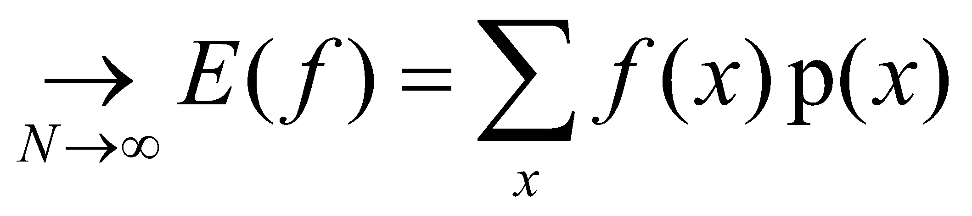
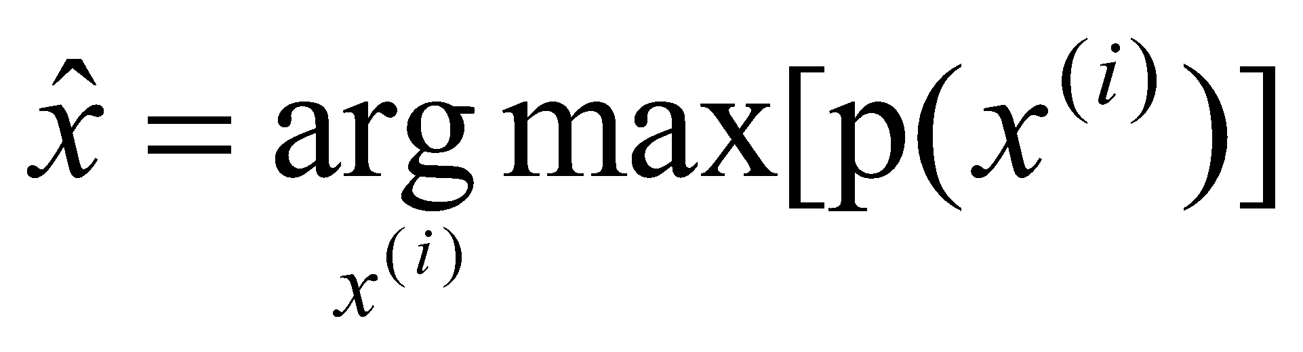
Monte Carlo principle
We can also use these samples to compute expectations
And even use them to find a maximum

Slide 14
Example: Bayes net inference
F
Suppose we have a Bayesian network with variables X
Our state space is the set of all possible assignments of values to variables
Computing the joint distribution is in the worst case NP-hard
However, note that you can draw a sample in time that is linear in the size of the network
Draw N samples, use them to approximate the joint
F
T
T
F
F
T
F
T
T
T
T
F
T
F
F
T
F
Sample 1: FTFTTTFFT
Sample 2: FTFFTTTFF
etc.

Slide 15
Rejection sampling
F
Suppose we have a Bayesian network with variables X
We wish to condition on some evidence ZX and compute the posterior over Y=X-Z
Draw samples, rejecting them when they contradict the evidence in Z
Very inefficient if the evidence is itself improbable, because we must reject a large number of samples
F
T
T
F
F
T
F
T
F=
T
T
T
F
T
=T
F
F
T
F
Sample 1: FTFTTTFFT reject
Sample 2: FTFFTTTFF accept
etc.

Slide 16
Rejection sampling
More generally, we would like to sample from p(x), but it’s easier to sample from a proposal distribution q(x)
q(x) satisfies p(x) ≤ M q(x) for some M<∞
Procedure:
Sample x^{(i)} from q(x)
Accept with probability p(x^{(i)}) / Mq(x^{(i)})
Reject otherwise
The accepted x^{(i)} are sampled from p(x)!
Problem: if M is too large, we will rarely accept samples
In the Bayes network, if the evidence Z is very unlikely then we will reject almost all samples

Slide 17
Markov chain Monte Carlo
Recall again the set X and the distribution p(x) we wish to sample from
Suppose that it is hard to sample p(x) but that it is possible to “walk around” in X using only local state transitions
Insight: we can use a “random walk” to help us draw random samples from p(x)
p(x)
X

Slide 18
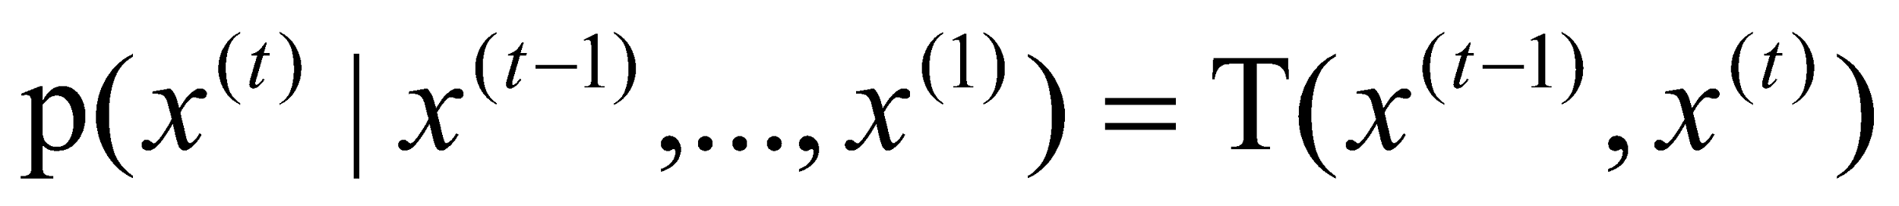
Markov chains
Markov chain on a space X with transitions T is a random process (infinite sequence of random variables)
(x⁽⁰⁾, x⁽¹⁾,…x^{(t)},…) in X∞ that satisfy
That is, the probability of being in a particular state at time t given the state history depends only on the state at time t-1
If the transition probabilities are fixed for all t, the chain is considered homogeneous
0.4
0.7
0.3
0
x₂
0.3
0.3
T=
0.3
0.4
0.3
0
0.3
0.7
0.7
0.3
0.3
0.7
x₁
x₃

Slide 19
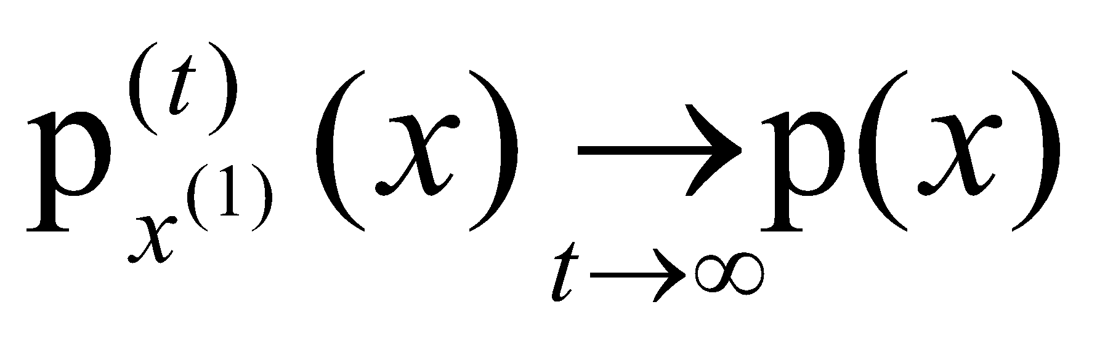
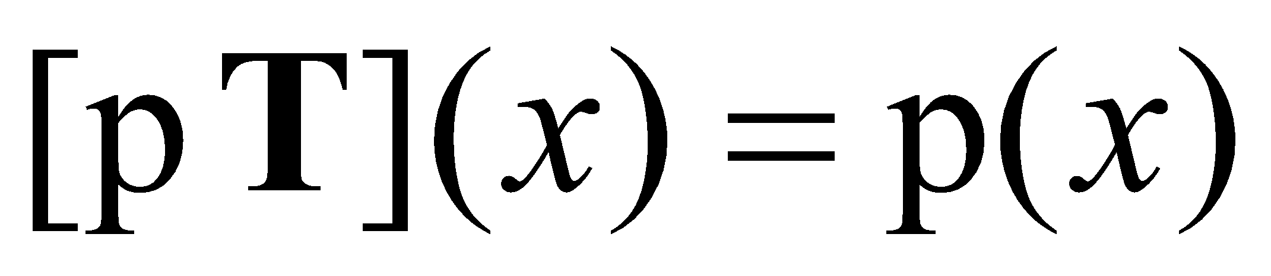
Markov Chains for sampling
In order for a Markov chain to useful for sampling p(x), we require that for any starting state x⁽¹⁾
Equivalently, the stationary distribution of the Markov chain must be p(x)
If this is the case, we can start in an arbitrary state, use the Markov chain to do a random walk for a while, and stop and output the current state x^{(t)}
The resulting state will be sampled from p(x)!

Slide 20
Stationary distribution
Consider the Markov chain given above:
The stationary distribution is
Some samples:
0.4
0.7
0.3
0
x₂
0.3
0.3
T=
0.3
0.4
0.3
0
0.3
0.7
0.7
0.3
0.3
0.7
x₁
x₃
0.33
0.33
0.33
x
0.7
0.3
0
=
0.33
0.33
0.33
0.3
0.4
0.3
0
0.3
0.7
1,1,2,3,2,1,2,3,3,2
1,2,2,1,1,2,3,3,3,3
1,1,1,2,3,2,2,1,1,1
1,2,3,3,3,2,1,2,2,3
1,1,2,2,2,3,3,2,1,1
1,2,2,2,3,3,3,2,2,2
Empirical Distribution:
0.33
0.33
0.33

Slide 21
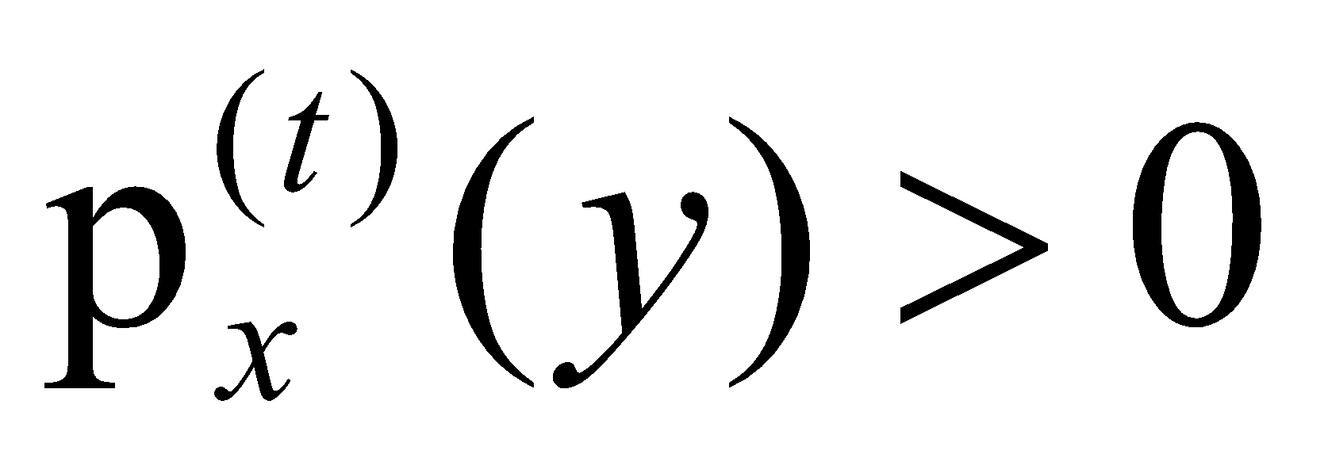
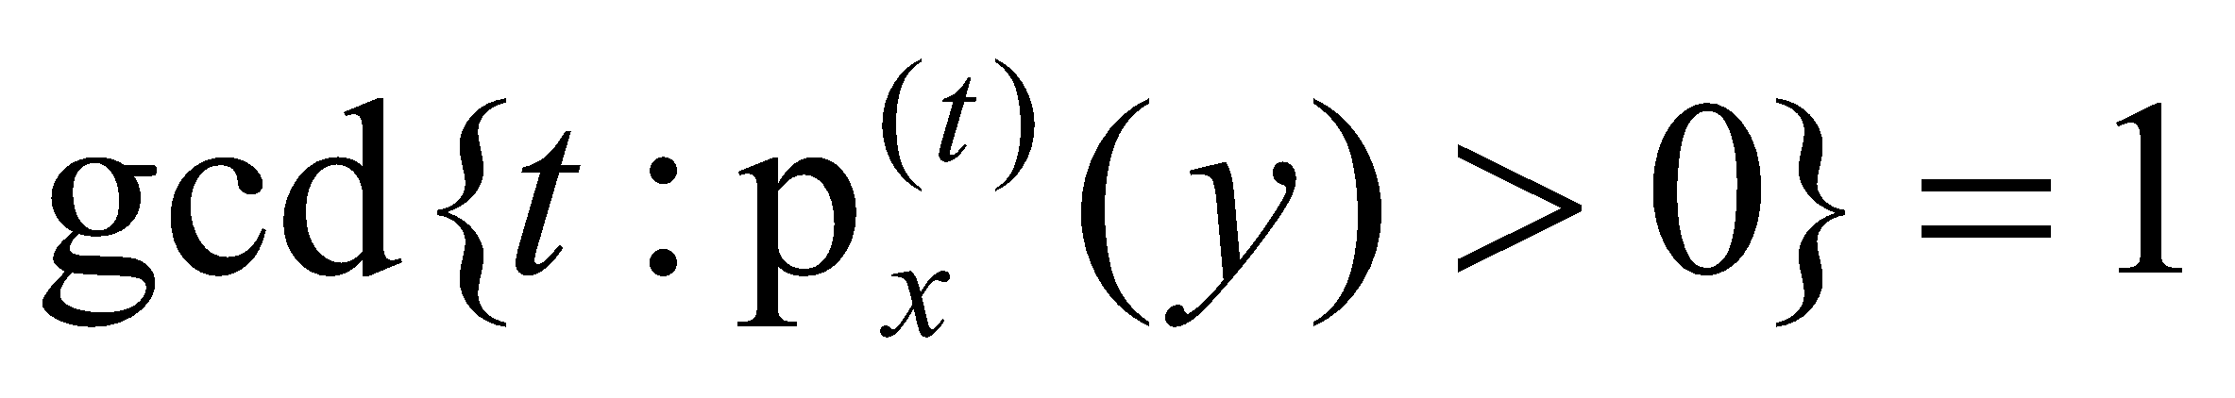
Ergodicity
Claim: To ensure that the chain converges to a unique stationary distribution the following conditions are sufficient:
Irreducibility: every state is eventually reachable from any start state; for all x, y in X there exists a t such that
Aperiodicity: the chain doesn’t get caught in cycles; for all x, y in X it is the case that
The process is ergodic if it is both irreducible and aperiodic
This claim is easy to prove, but involves eigenstuff!

Slide 22
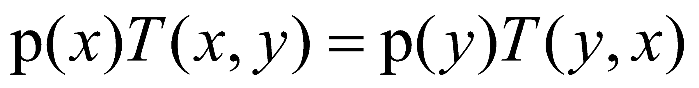
Markov Chains for sampling
Claim: To ensure that the stationary distribution of the Markov chain is p(x) it is sufficient for p and T to satisfy the detailed balance (reversibility) condition:
Proof: for all y we have
And thus p must be a stationary distribution of T

Slide 23
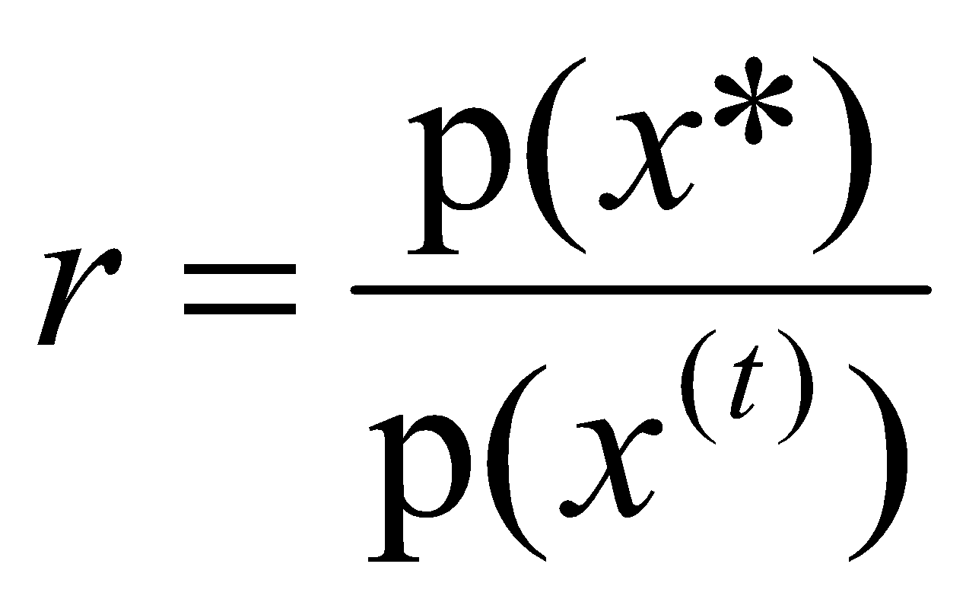
Metropolis algorithm
How to pick a suitable Markov chain for our distribution?
Suppose our distribution p(x) is easy to sample, and easy to compute up to a normalization constant, but hard to compute exactly
e.g. a Bayesian posterior P(M|D)∝P(D|M)P(M)
We define a Markov chain with the following process:
Sample a candidate point x* from a proposal distribution q(x*|x^{(t)}) which is symmetric: q(x|y)=q(y|x)
Compute the importance ratio (this is easy since the normalization constants cancel)
With probability min(r,1) transition to x*, otherwise stay in the same state

Slide 24
Metropolis intuition
Why does the Metropolis algorithm work?
Proposal distribution can propose anything it likes (as long as it can jump back with the same probability)
Proposal is always accepted if it’s jumping to a more likely state
Proposal accepted with the importance ratio if it’s jumping to a less likely state
The acceptance policy, combined with the reversibility of the proposal distribution, makes sure that the algorithm explores states in proportion to p(x)!
r=1.0
r=p(x*)/p(x^{t})
x*
x^{t}
x*

Slide 25
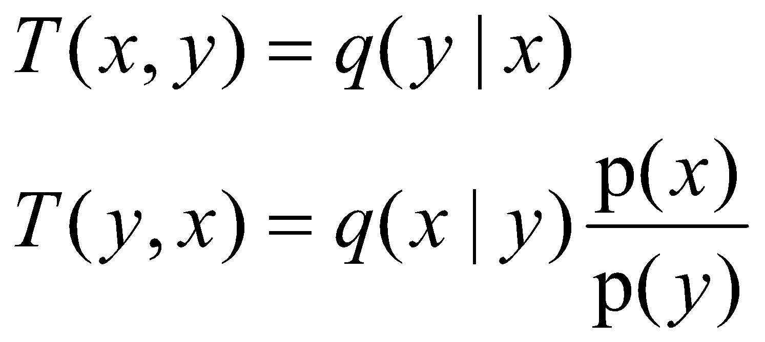
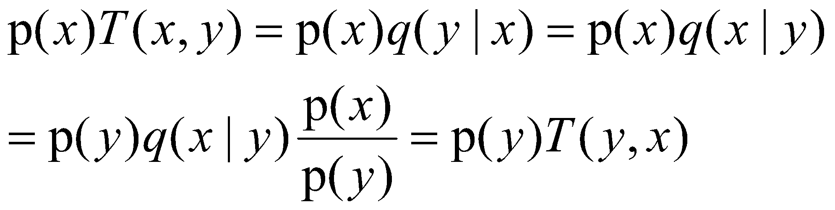
Metropolis convergence
Claim: The Metropolis algorithm converges to the target distribution p(x).
Proof: It satisfies detailed balance
For all x,y in X, wlog assuming p(x)<p(y), then
Hence:
candidate is always accepted, since the r= 1
Since, w generate x with prob q(x|y) and accept
with prob r = the ratio < 1.
q is symmetric

Slide 26
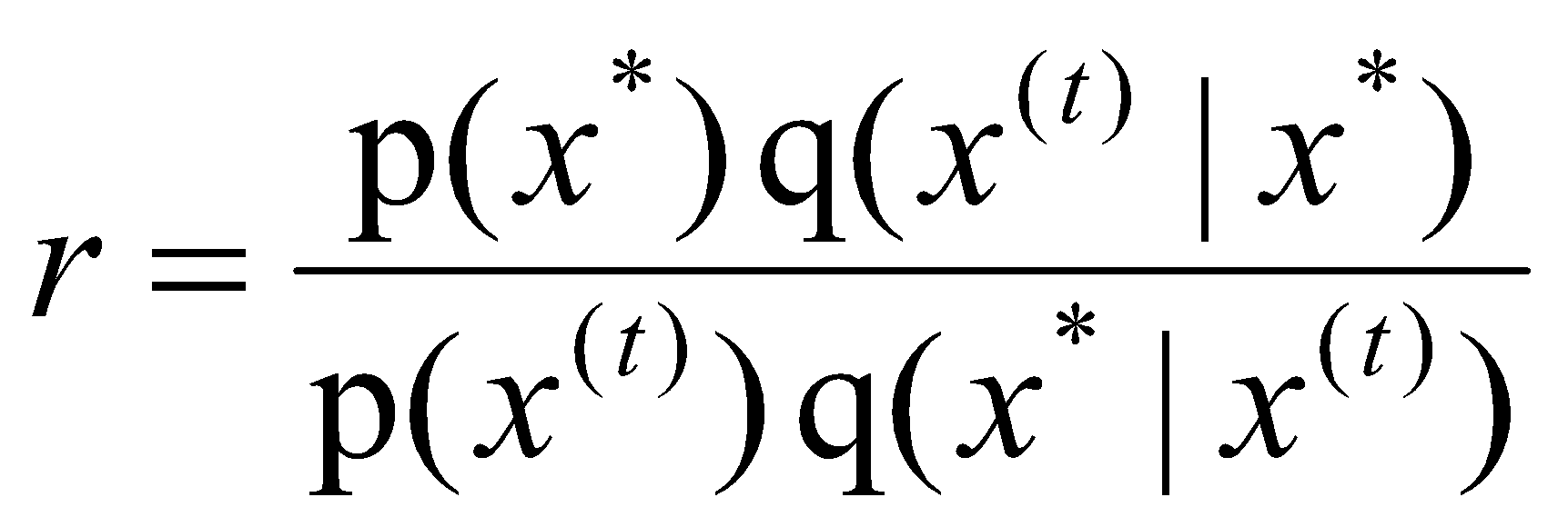
Metropolis-Hastings
The symmetry requirement of the Metropolis proposal distribution can be hard to satisfy
Metropolis-Hastings is the natural generalization of the Metropolis algorithm, and the most popular MCMC algorithm
We define a Markov chain with the following process:
Sample a candidate point x* from a proposal distribution q(x*|x^{(t)}) which is not necessarily symmetric
Compute the importance ratio:
With probability min(r,1) transition to x*, otherwise stay in the same state x^{(t)}

Slide 27
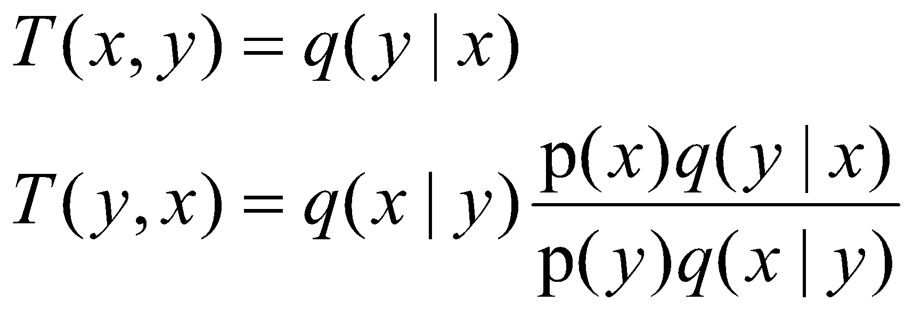
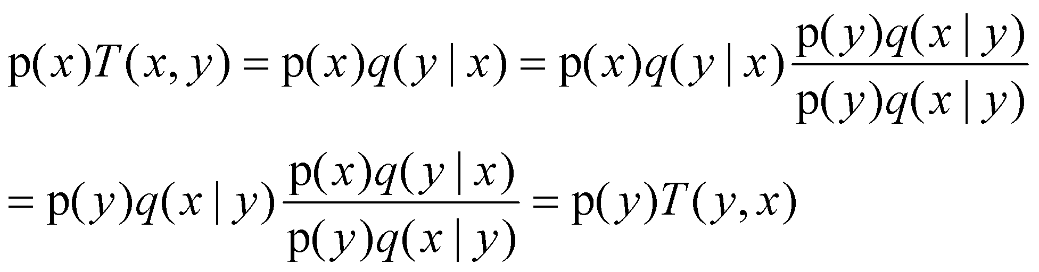
MH convergence
Claim: The Metropolis-Hastings algorithm converges to the target distribution p(x).
Proof: It satisfies detailed balance
For all x,y in X, wlog assume p(x)q(y|x)<p(y)q(x|y), then
Hence:
candidate is always accepted, since r = 1
Since, w generate x with prob q(x|y) and accept
with prob r = the ratio < 1.

Slide 28
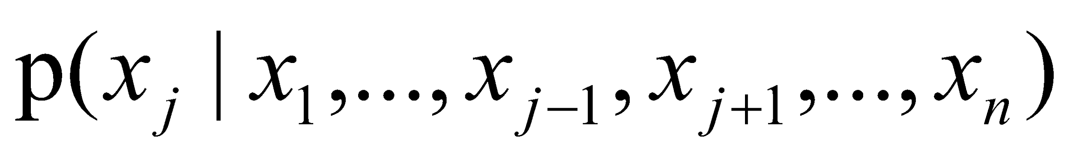
Gibbs sampling
A special case of Metropolis-Hastings which is applicable to state spaces in which we have a factored state space, and access to the full conditionals:
Perfect for Bayesian networks!
Idea: To transition from one state (variable assignment) to another,
Pick a variable,
Sample its value from the conditional distribution
That’s it!
We’ll show in a minute why this is an instance of MH and thus must be sampling from the full joint

Slide 29
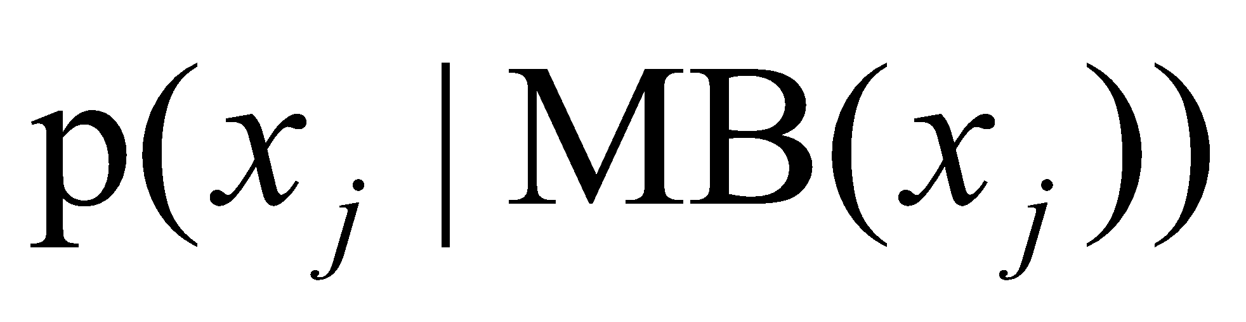
Markov blanket
Recall that Bayesian networks encode a factored representation of the joint distribution
Variables are independent of their non-descendents given their parents
Variables are independent of everything else in the network given their Markov blanket!
So, to sample each node, we only need to condition its Markov blanket

Slide 30
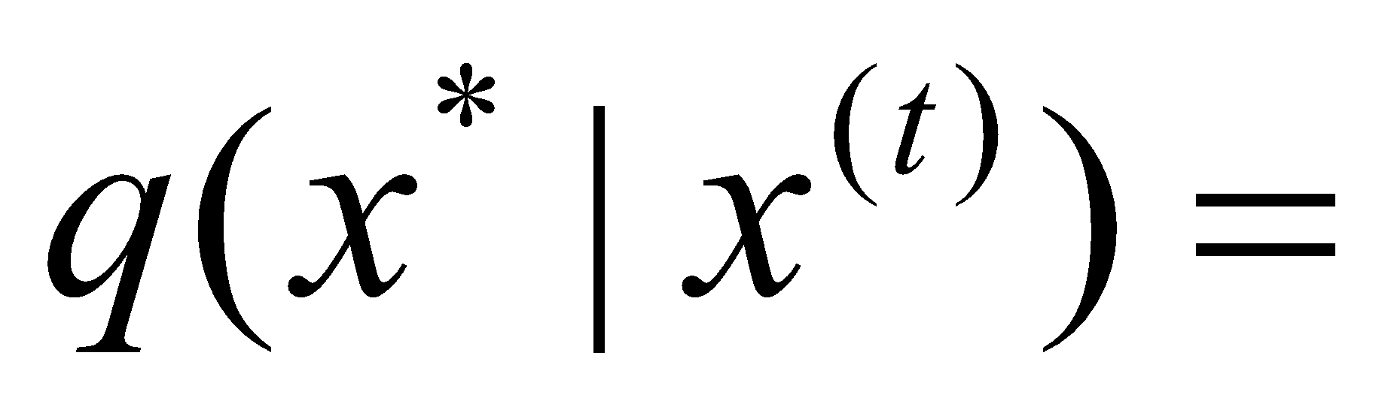
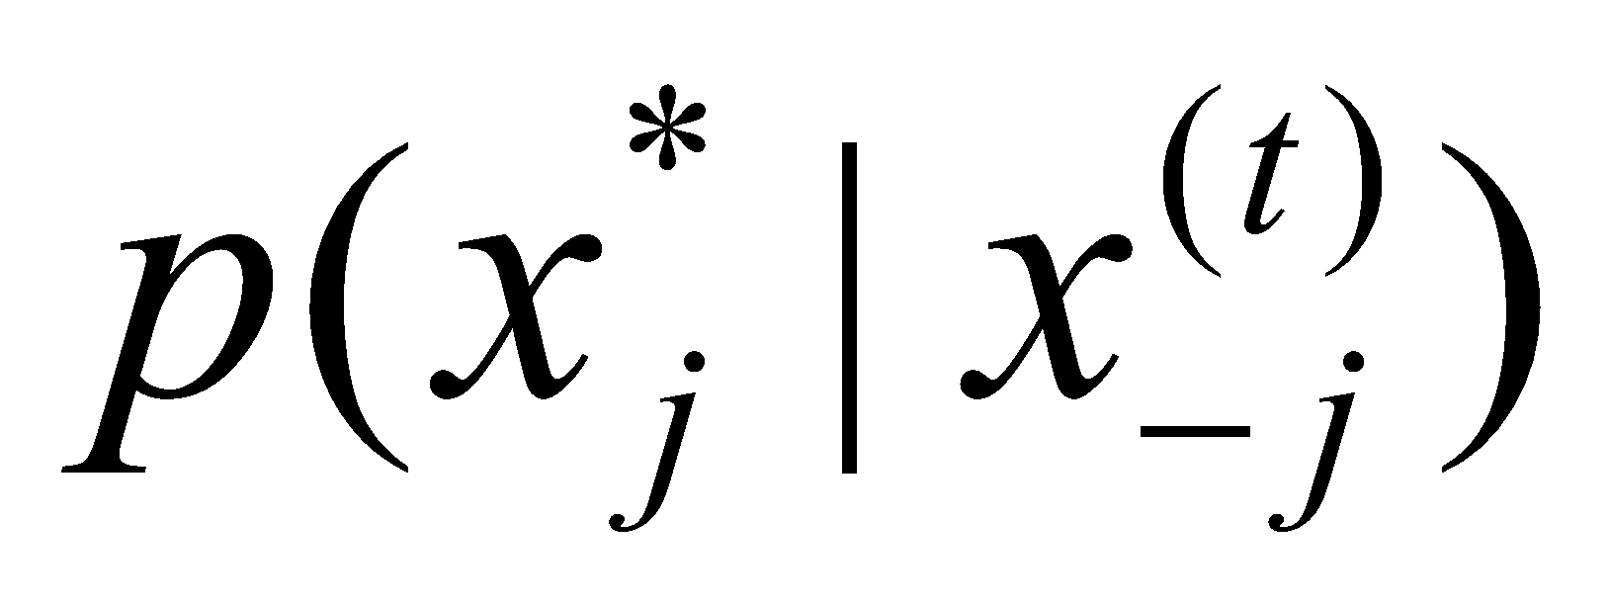

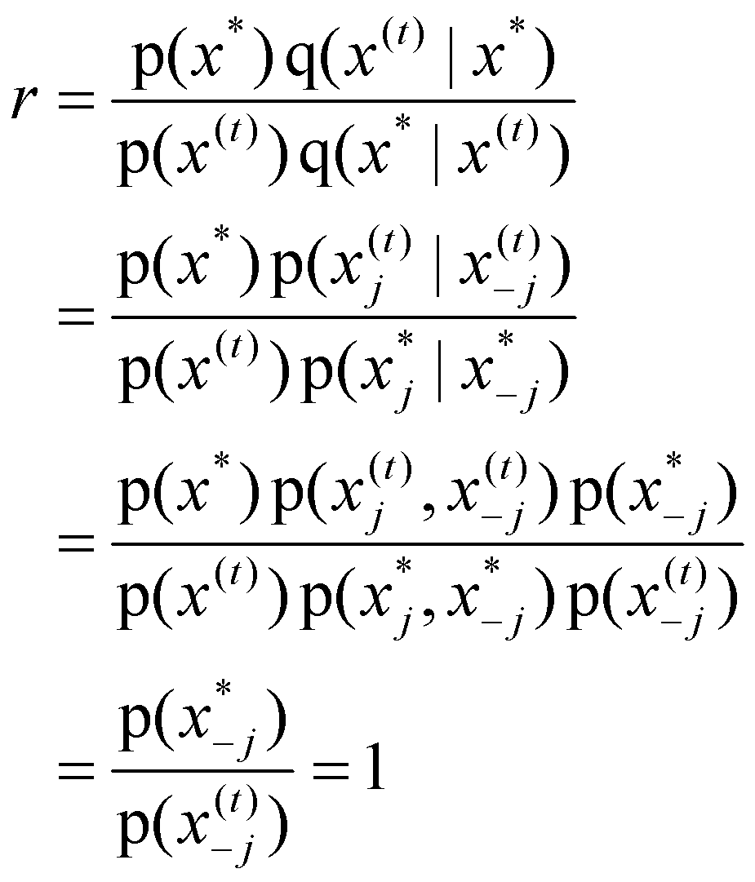
Gibbs sampling
More formally, the proposal distribution is
The importance ratio is
So we always accept!
if x*_{-j}=x^{(t)}_{-j}
otherwise
Dfn of proposal distribution
Dfn of conditional probability
B/c we didn’t change other vars

Slide 31
Practical issues
How many iterations?
How to know when to stop?
What’s a good proposal function?

Slide 32
Advanced Topics
Simulated annealing, for global optimization, is a form of MCMC
Mixtures of MCMC transition functions
Monte Carlo EM (stochastic E-step)
Reversible jump MCMC for model selection
Adaptive proposal distributions

